Slide 1

Analysis of Algorithms
Asymptotic Analysis

Slide 2
Analysis of Algorithms
An algorithm is a finite set of precise instructions for performing a computation or for solving a problem.
What is the goal of analysis of algorithms?
To compare algorithms mainly in terms of running time but also in terms of other factors (e.g., memory requirements, programmer's effort etc.)
What do we mean by running time analysis?
Determine how running time increases as the size of the problem increases.
‹#›

Slide 3
Input Size
Input size (number of elements in the input)
size of an array
polynomial degree
# of elements in a matrix
# of bits in the binary representation of the input
vertices and edges in a graph
‹#›

Slide 4
Types of Analysis
Worst case
Provides an upper bound on running time
An absolute guarantee that the algorithm would not run longer, no matter what the inputs are
Best case
Provides a lower bound on running time
Input is the one for which the algorithm runs the fastest
Average case
Provides a prediction about the running time
Assumes that the input is random
‹#›

Slide 5
How do we compare algorithms?
We need to define a number of objective measures.
(1) Compare execution times?
Not good: times are specific to a particular computer !!
(2) Count the number of statements executed?
Not good: number of statements vary with the programming language as well as the style of the individual programmer.
‹#›

Slide 6
Ideal Solution
Express running time as a function of the input size n (i.e., f(n)).
Compare different functions corresponding to running times.
Such an analysis is independent of machine time, programming style, etc.
‹#›

Slide 7
Example
Associate a "cost" with each statement.
Find the "total cost“ by finding the total number of times each statement is executed.
Algorithm 1 Algorithm 2
Cost Cost
arr[0] = 0; c₁ for(i=0; i<N; i++) c₂
arr[1] = 0; c₁ arr[i] = 0; c₁
arr[2] = 0; c₁
... ...
arr[N-1] = 0; c₁
----------- -------------
c₁+c₁+...+c₁ = c₁ x N (N+1) x c₂ + N x c₁ =
(c₂ + c₁) x N + c₂
‹#›

Slide 8
Another Example
Algorithm 3 Cost
sum = 0; c₁
for(i=0; i<N; i++) c₂
for(j=0; j<N; j++) c₂
sum += arr[i][j]; c₃
------------
c₁ + c₂ x (N+1) + c₂ x N x (N+1) + c₃ x N²
‹#›

Slide 9
Asymptotic Analysis
To compare two algorithms with running times f(n) and g(n), we need a rough measure that characterizes how fast each function grows.
Hint: use rate of growth
Compare functions in the limit, that is, asymptotically!
(i.e., for large values of n)
‹#›

Slide 10
Rate of Growth
Consider the example of buying elephants and goldfish:
Cost: cost_of_elephants + cost_of_goldfish
Cost ~ cost_of_elephants (approximation)
The low order terms in a function are relatively insignificant for large n
n⁴ + 100n² + 10n + 50 ~ n⁴
i.e., we say that n⁴ + 100n² + 10n + 50 and n⁴ have the same rate of growth
‹#›

Slide 11
Asymptotic Notation
O notation: asymptotic “less than”:
f(n)=O(g(n)) implies: f(n) “≤” g(n)
Ω notation: asymptotic “greater than”:
f(n)= Ω (g(n)) implies: f(n) “≥” g(n)
Θ notation: asymptotic “equality”:
f(n)= Θ (g(n)) implies: f(n) “=” g(n)
‹#›

Slide 12
Big-O Notation
We say f_{A}(n)=30n+8 is order n, or O (n) It is, at most, roughly proportional to n.
f_{B}(n)=n²+1 is order n², or O(n²). It is, at most, roughly proportional to n².
In general, any O(n²) function is faster- growing than any O(n) function.
‹#›

Slide 13
Visualizing Orders of Growth
On a graph, as you go to the right, a faster growing function eventually becomes larger...
f_{A}(n)=30n+8
Value of function →
f_{B}(n)=n²+1
Increasing n →
‹#›

Slide 14
More Examples …
n⁴ + 100n² + 10n + 50 is O(n⁴)
10n³ + 2n² is O(n³)
n³ - n² is O(n³)
constants
10 is O(1)
1273 is O(1)
‹#›

Slide 15
Back to Our Example
Algorithm 1 Algorithm 2
Cost Cost
arr[0] = 0; c₁ for(i=0; i<N; i++) c₂
arr[1] = 0; c₁ arr[i] = 0; c₁
arr[2] = 0; c₁
...
arr[N-1] = 0; c₁
----------- -------------
c₁+c₁+...+c₁ = c₁ x N (N+1) x c₂ + N x c₁ =
(c₂ + c₁) x N + c₂
Both algorithms are of the same order: O(N)
‹#›

Slide 16
Example (cont’d)
Algorithm 3 Cost
sum = 0; c₁
for(i=0; i<N; i++) c₂
for(j=0; j<N; j++) c₂
sum += arr[i][j]; c₃
------------
c₁ + c₂ x (N+1) + c₂ x N x (N+1) + c₃ x N² = O(N²)
‹#›

Slide 17
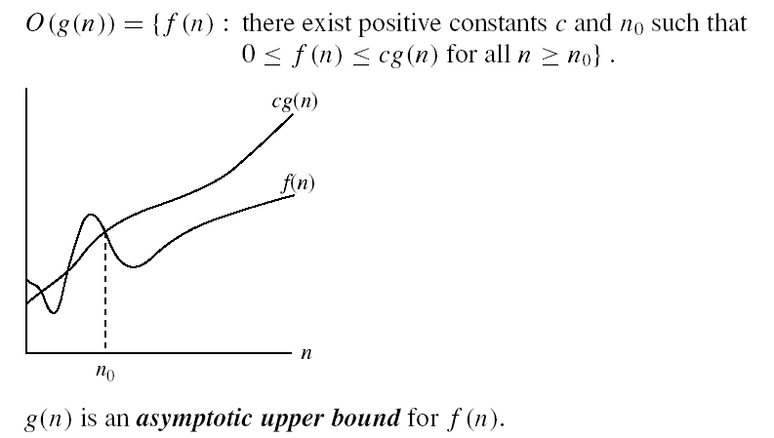
Asymptotic notations
O-notation
‹#›

Slide 18
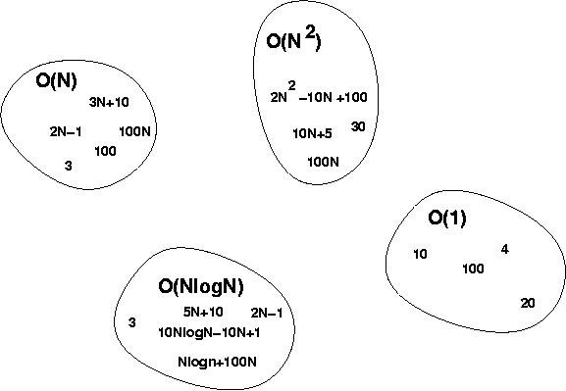
Big-O Visualization
O(g(n)) is the set of functions with smaller or same order of growth as g(n)
‹#›

Slide 19
Examples
2n² = O(n³):
n² = O(n²):
1000n²+1000n = O(n²):
n = O(n²):
2n² ≤ cn³ ⇒ 2 ≤ cn ⇒ c = 1 and n₀= 2
n² ≤ cn² ⇒ c ≥ 1 ⇒ c = 1 and n₀= 1
1000n²+1000n ≤ 1000n²+ n² =1001n²⇒ c=1001 and n₀ = 1000
n ≤ cn² ⇒ cn ≥ 1 ⇒ c = 1 and n₀= 1
‹#›

Slide 20
More Examples
Show that 30n+8 is O(n).
Show ∃c,n₀: 30n+8 ≤ cn, ∀n>n₀ .
Let c=31, n₀=8. Assume n>n₀=8. Then cn = 31n = 30n + n > 30n+8, so 30n+8 < cn.
‹#›

Slide 21
Big-O example, graphically
Note 30n+8 isn’t less than n anywhere (n>0).
It isn’t even less than 31n everywhere.
But it is less than 31n everywhere to the right of n=8.
cn = 31n
30n+8
30n+8 ∈O(n)
Value of function →
n
n>n₀=8 →
Increasing n →
‹#›

Slide 22
No Uniqueness
There is no unique set of values for n₀ and c in proving the asymptotic bounds
Prove that 100n + 5 = O(n²)
100n + 5 ≤ 100n + n = 101n ≤ 101n²
for all n ≥ 5
n₀ = 5 and c = 101 is a solution
100n + 5 ≤ 100n + 5n = 105n ≤ 105n² for all n ≥ 1
n₀ = 1 and c = 105 is also a solution
Must find SOME constants c and n₀ that satisfy the asymptotic notation relation
‹#›

Slide 23
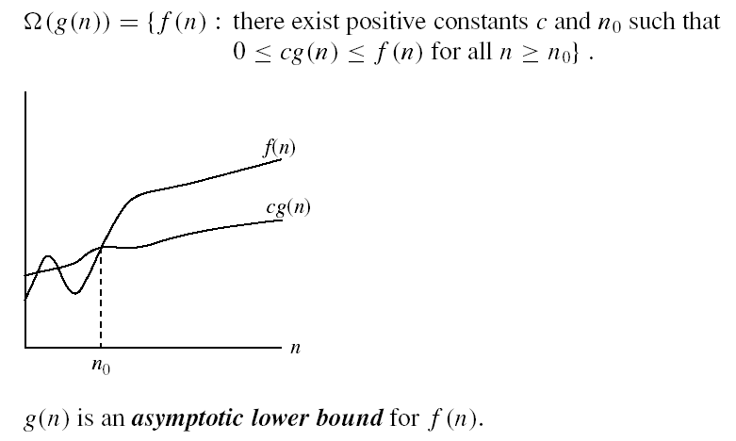
Asymptotic notations (cont.)
Ω - notation
Ω(g(n)) is the set of functions with larger or same order of growth as g(n)
‹#›

Slide 24
Examples
5n² = Ω(n)
100n + 5 ≠ Ω(n²)
n = Ω(2n), n³ = Ω(n²), n = Ω(logn)
∃ c, n₀ such that: 0 ≤ cn ≤ 5n²
⇒ cn ≤ 5n²
⇒ c = 5 and n₀ = 1
∃ c, n₀ such that: 0 ≤ cn² ≤ 100n + 5
100n + 5 ≤ 100n + 5n (∀ n ≥ 1) = 105n
cn² ≤ 105n
⇒ n(cn – 105) ≤ 0
Since n is positive ⇒ cn – 105 ≤ 0
⇒ n ≤ 105/c
⇒ contradiction: n cannot be smaller than a constant
‹#›

Slide 25

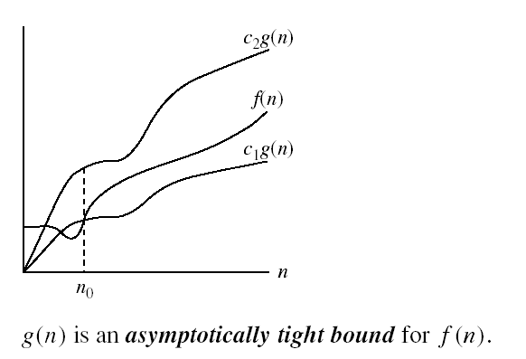
Asymptotic notations (cont.)
Θ-notation
Θ(g(n)) is the set of functions with the same order of growth as g(n)
‹#›

Slide 26
Examples
n²/2 –n/2 = Θ(n²)
½ n² - ½ n ≤ ½ n² ∀n ≥ 0 ⇒ c₂= ½
½ n² - ½ n ≥ ½ n² - ½ n * ½ n ( ∀n ≥ 2 ) = ¼ n² ⇒ c₁= ¼
n ≠ Θ(n²): c₁ n² ≤ n ≤ c₂ n²
⇒ only holds for: n ≤ 1/c₁
‹#›

Slide 27
Examples
6n³ ≠ Θ(n²): c₁ n² ≤ 6n³ ≤ c₂ n²
⇒ only holds for: n ≤ c₂ /6
n ≠ Θ(logn): c₁ logn ≤ n ≤ c₂ logn
⇒ c₂ ≥ n/logn, ∀ n≥ n₀ – impossible
‹#›

Slide 28
Relations Between Different Sets
Subset relations between order-of-growth sets.
R→R
O( f )
Ω( f )
• f
Θ( f )
‹#›

Slide 29
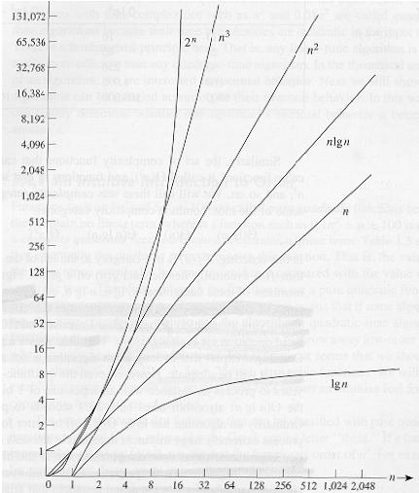
Common orders of magnitude
‹#›

Slide 30
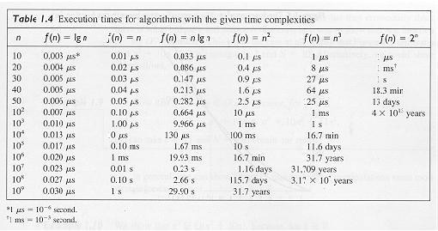
Common orders of magnitude
‹#›

Slide 31
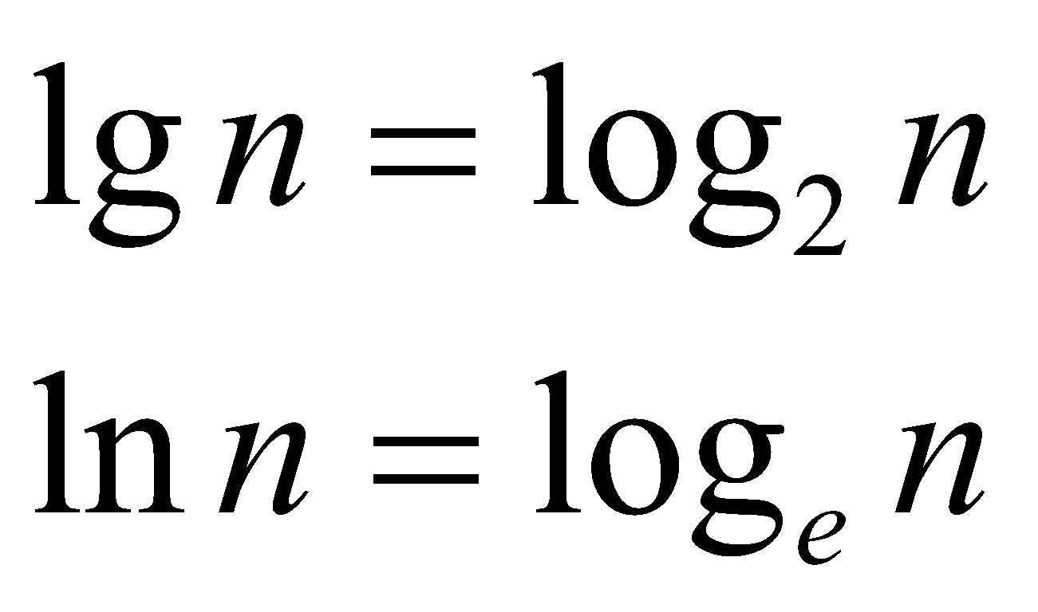
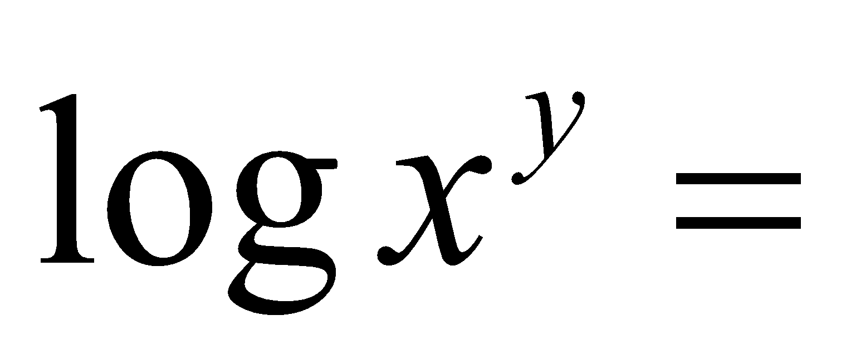
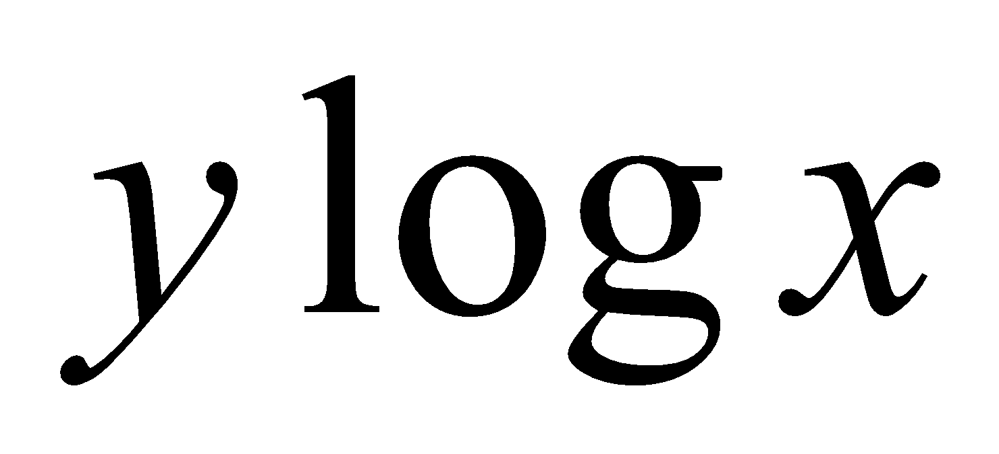
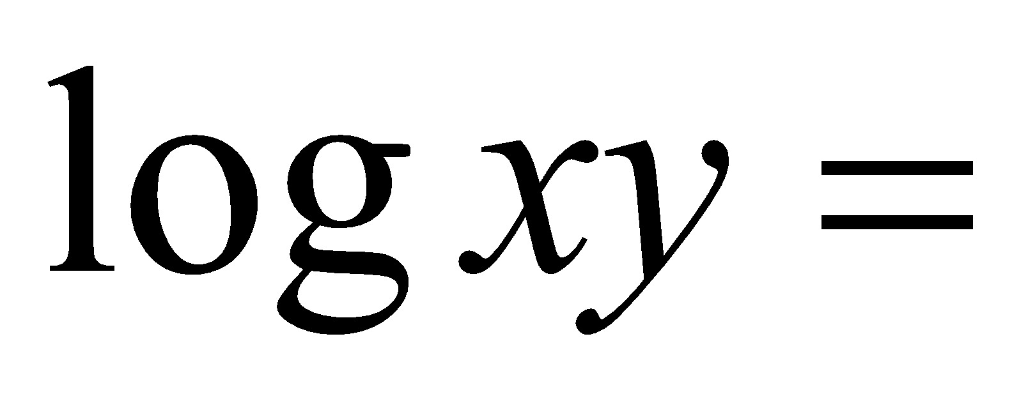
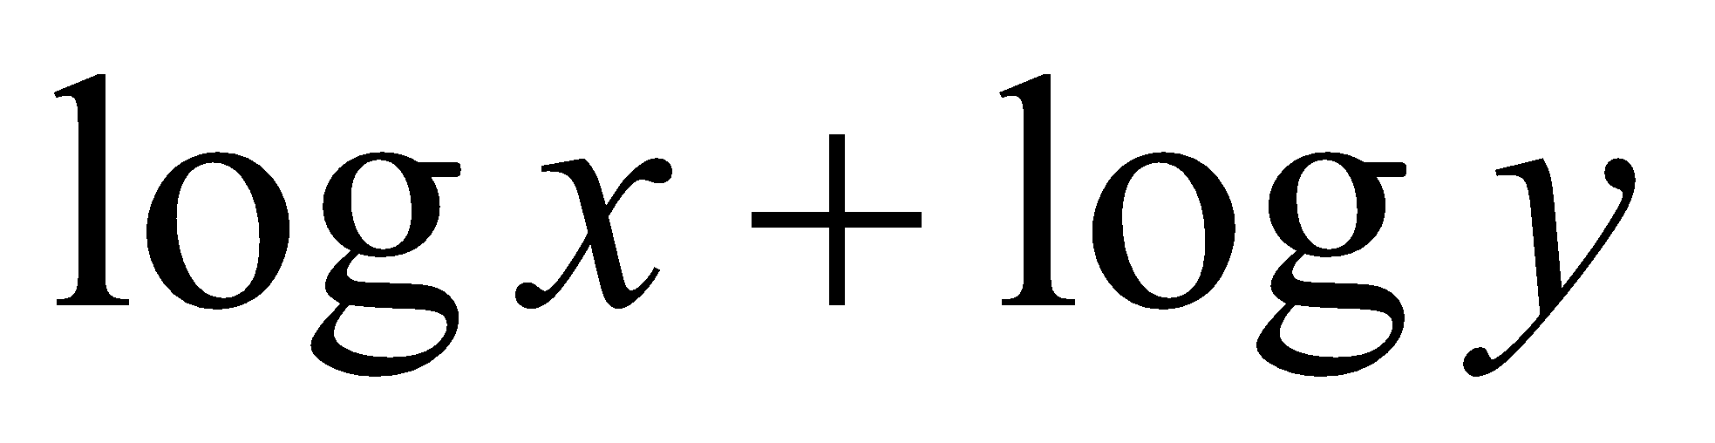
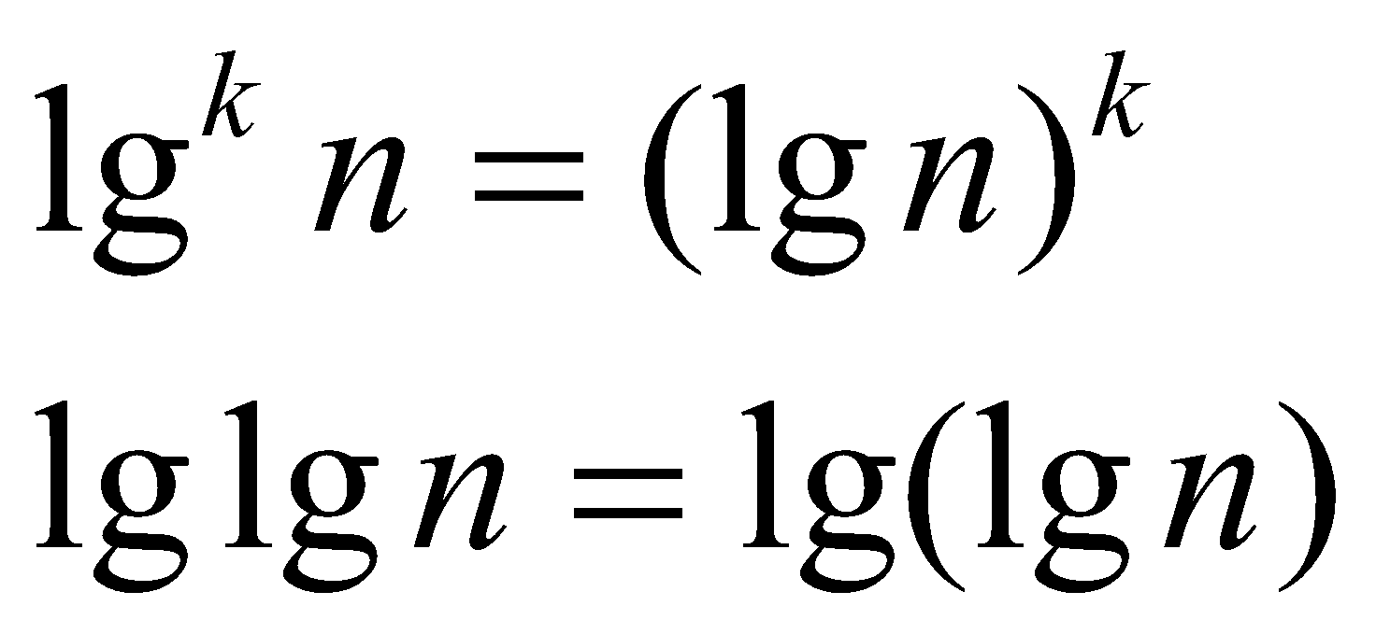
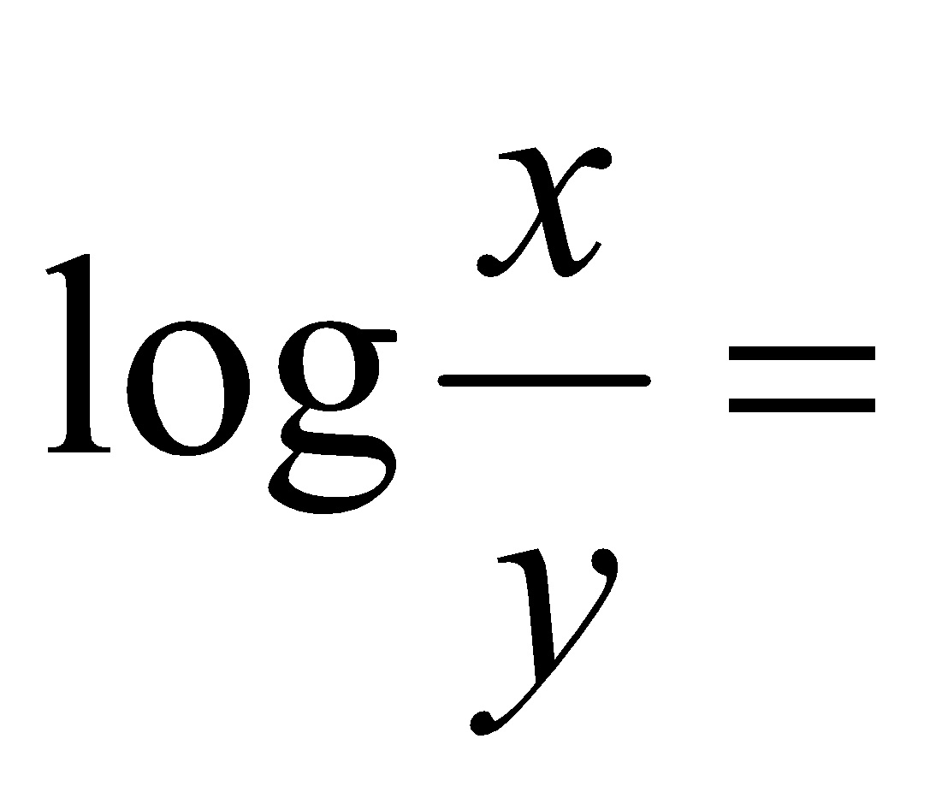
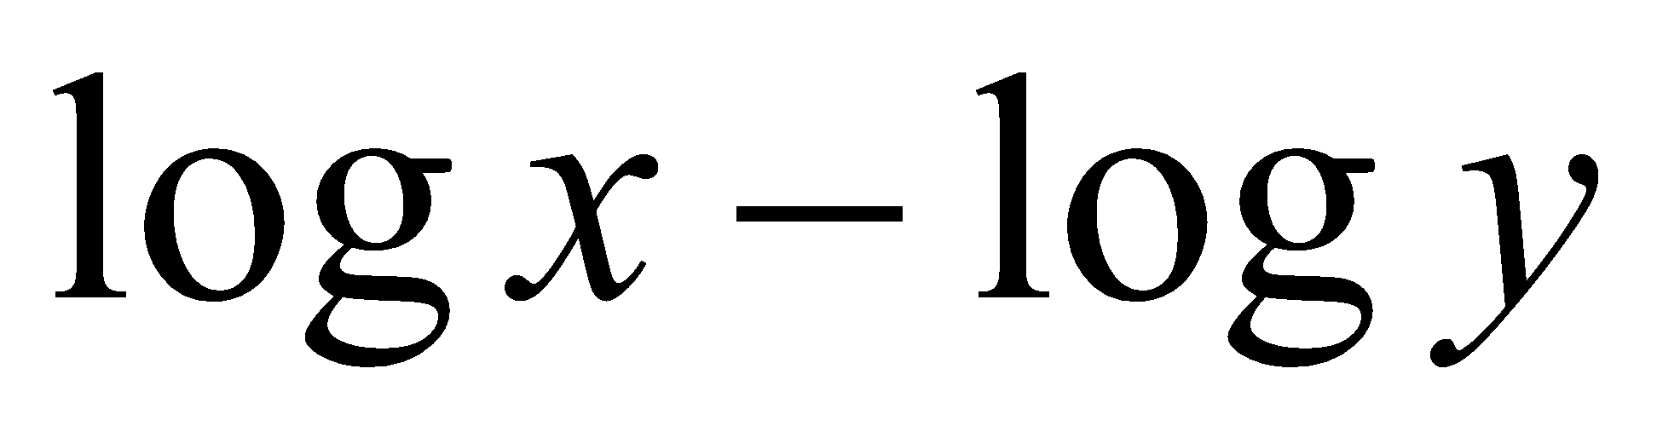
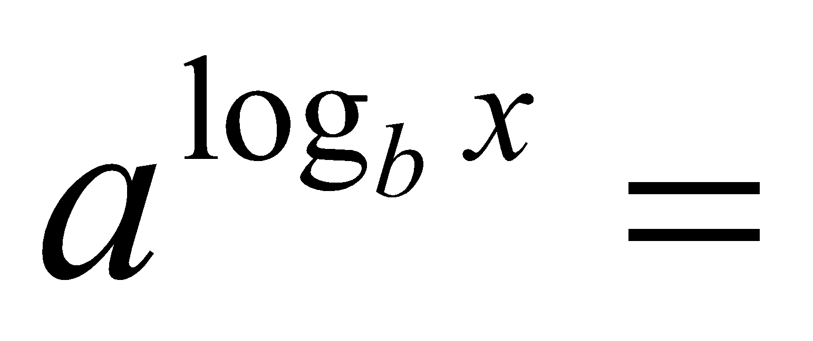
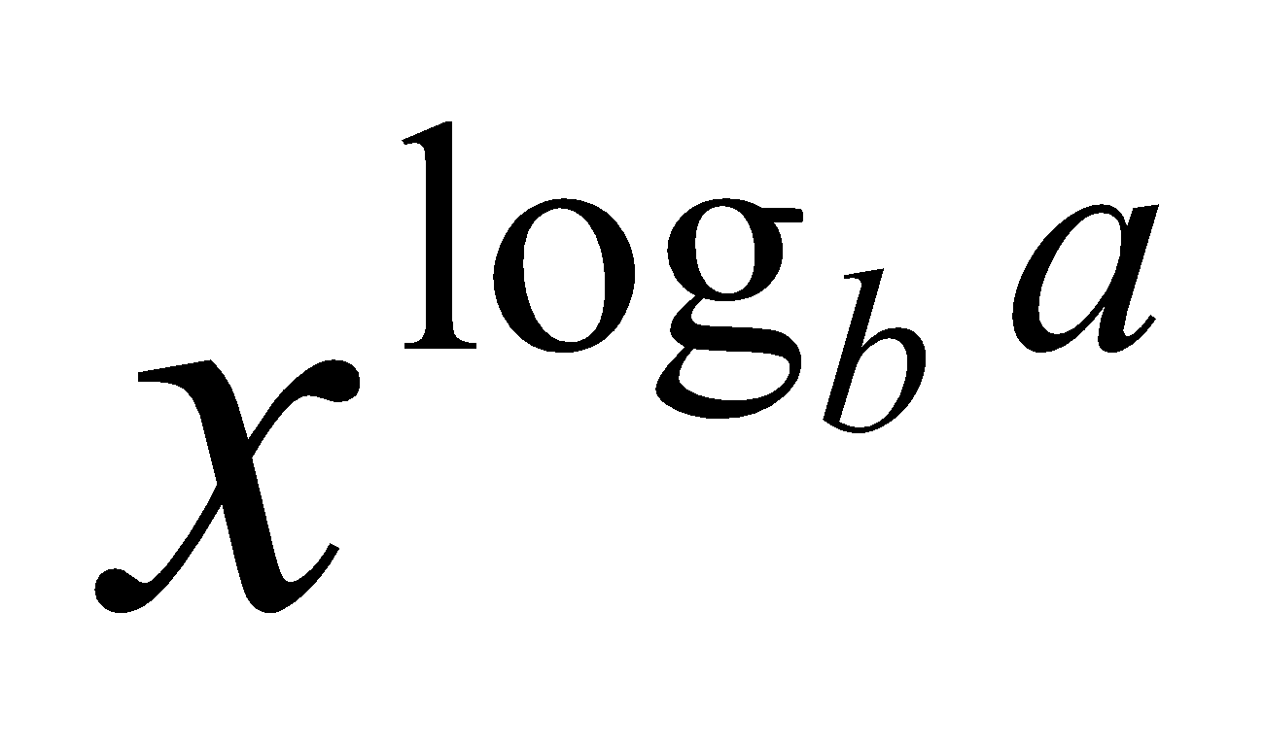
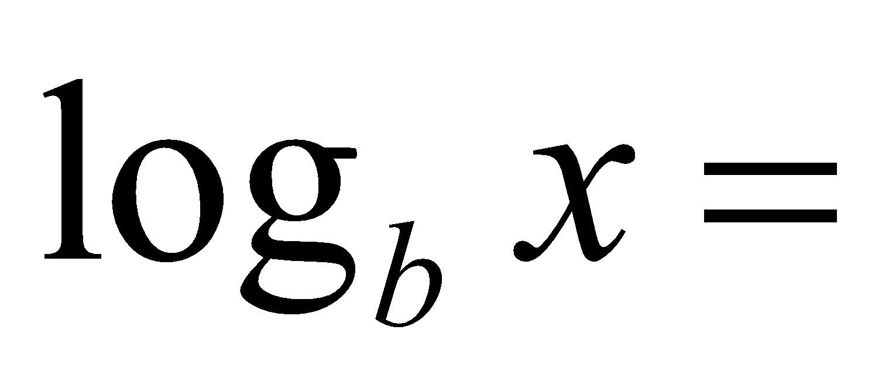
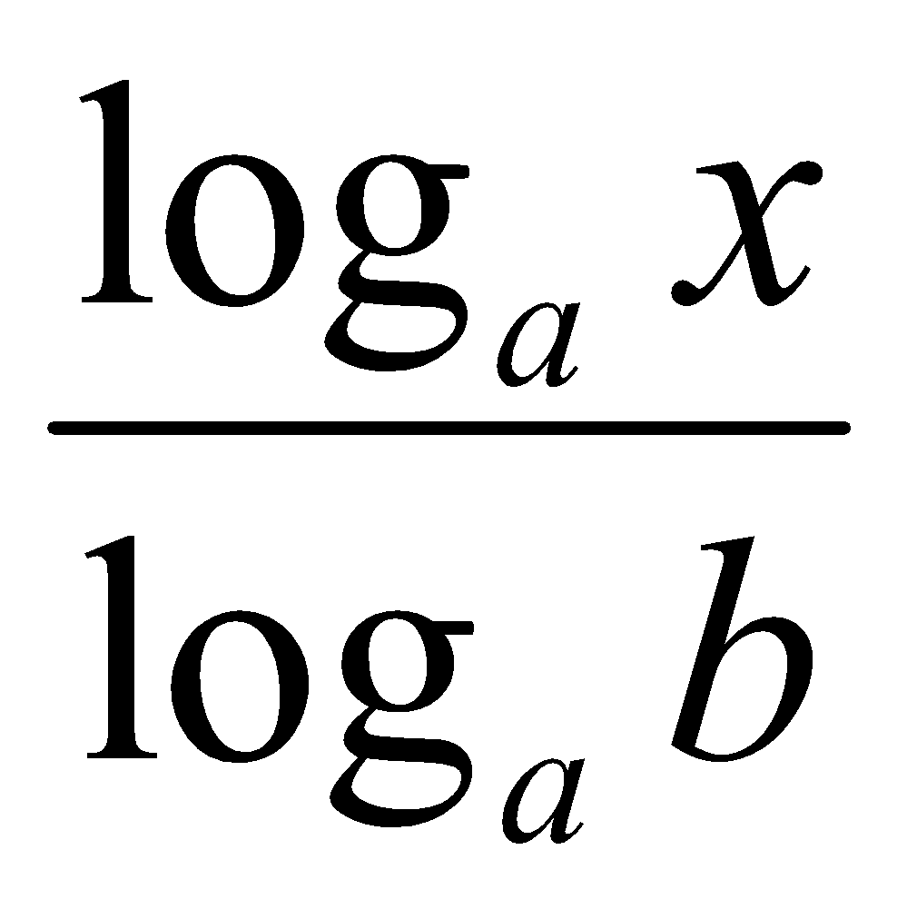
Logarithms and properties
In algorithm analysis we often use the notation “log n” without specifying the base
Binary logarithm
Natural logarithm
‹#›

Slide 32
More Examples
For each of the following pairs of functions, either f(n) is O(g(n)), f(n) is Ω(g(n)), or f(n) = Θ(g(n)). Determine which relationship is correct.
f(n) = log n²; g(n) = log n + 5
f(n) = n; g(n) = log n²
f(n) = log log n; g(n) = log n
f(n) = n; g(n) = log² n
f(n) = n log n + n; g(n) = log n
f(n) = 10; g(n) = log 10
f(n) = 2^{n}; g(n) = 10n²
f(n) = 2^{n}; g(n) = 3^{n}
f(n) = Θ(g(n))
f(n) =Ω(g(n))
f(n) =O(g(n))
f(n) =Ω(g(n))
f(n) =Ω(g(n))
f(n) =Θ(g(n))
f(n) =Ω(g(n))
f(n) =O(g(n))
‹#›

Slide 33
Properties
Theorem:
f(n) = Θ(g(n)) ⇔ f = O(g(n)) and f = Ω(g(n))
Transitivity:
f(n) = Θ(g(n)) and g(n) = Θ(h(n)) ⇒ f(n) = Θ(h(n))
Same for O and Ω
Reflexivity:
f(n) = Θ(f(n))
Same for O and Ω
Symmetry:
f(n) = Θ(g(n)) if and only if g(n) = Θ(f(n))
Transpose symmetry:
f(n) = O(g(n)) if and only if g(n) = Ω(f(n))
‹#›

Slide 34
Asymptotic Notations in Equations
On the right-hand side
Θ(n²) stands for some anonymous function in Θ(n²)
2n² + 3n + 1 = 2n² + Θ(n) means:
There exists a function f(n) ∈ Θ(n) such that
2n² + 3n + 1 = 2n² + f(n)
On the left-hand side
2n² + Θ(n) = Θ(n²)
No matter how the anonymous function is chosen on the left-hand side, there is a way to choose the anonymous function on the right-hand side to make the equation valid.
‹#›

Slide 35
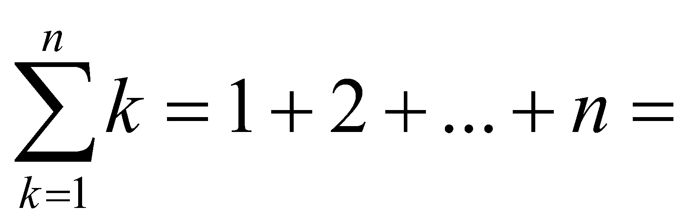
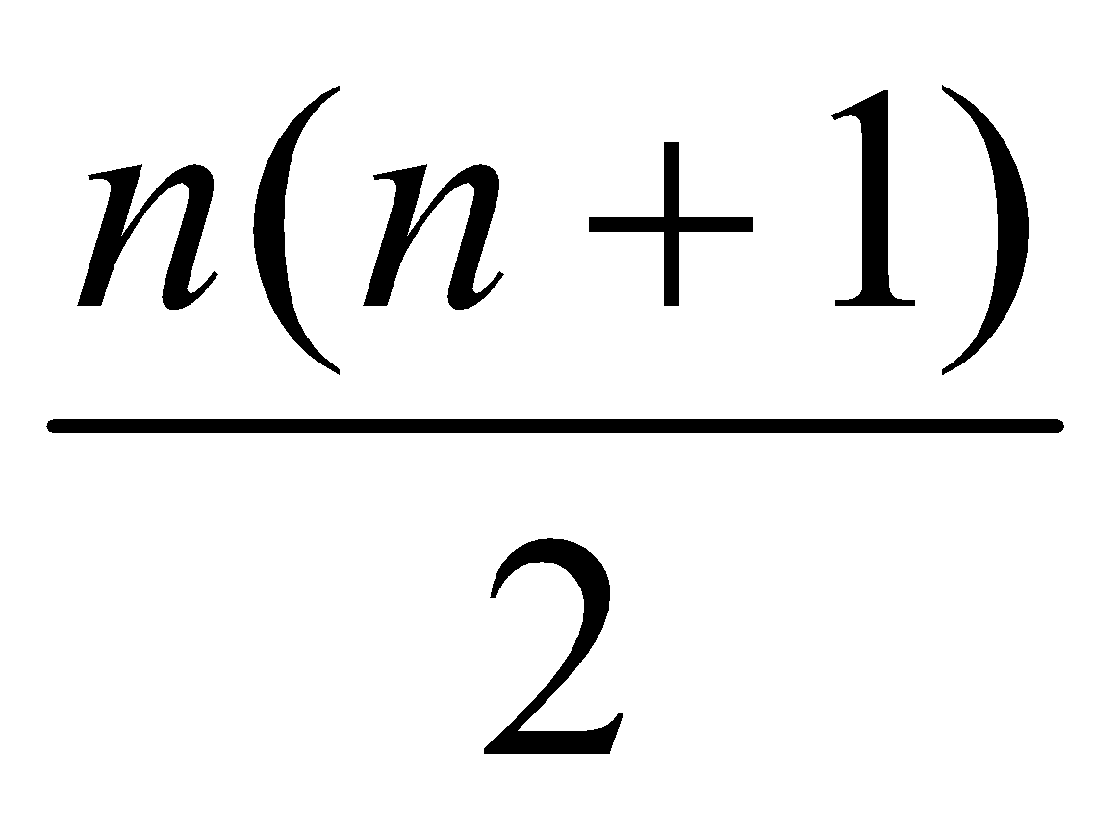
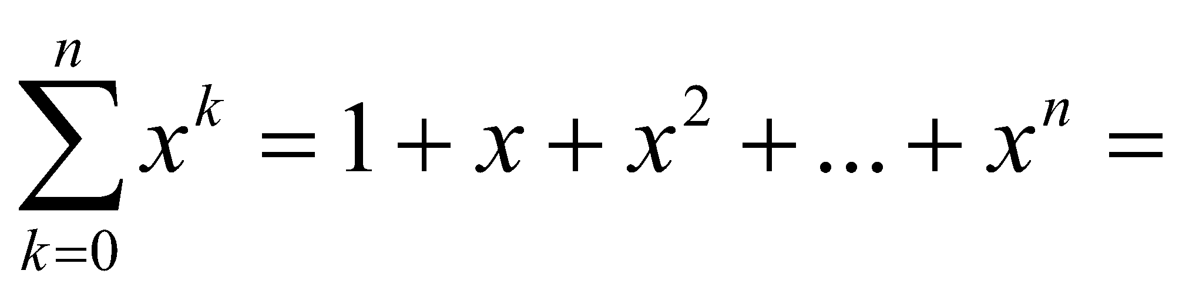
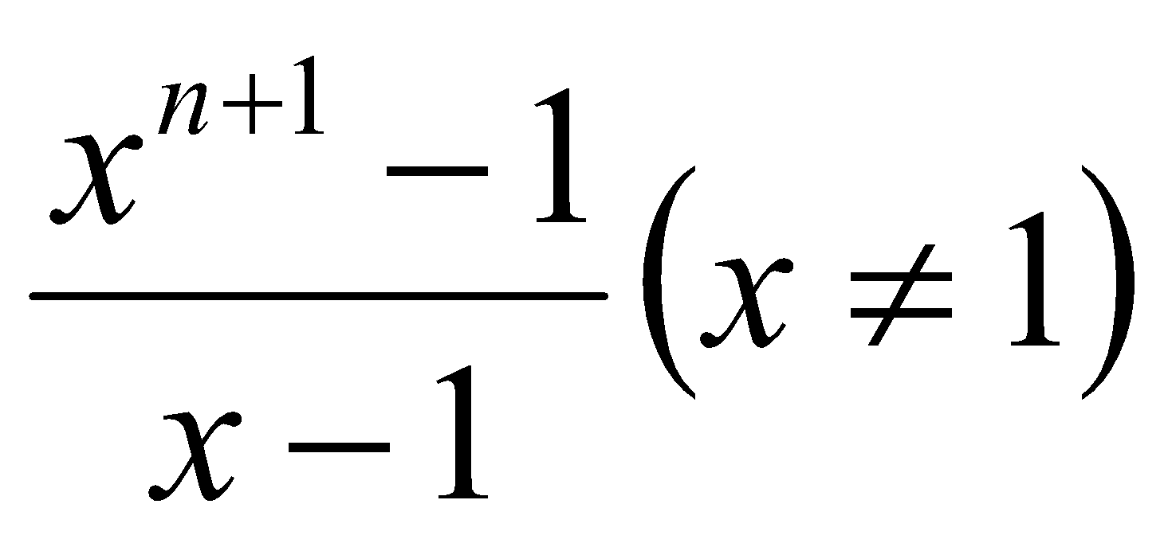
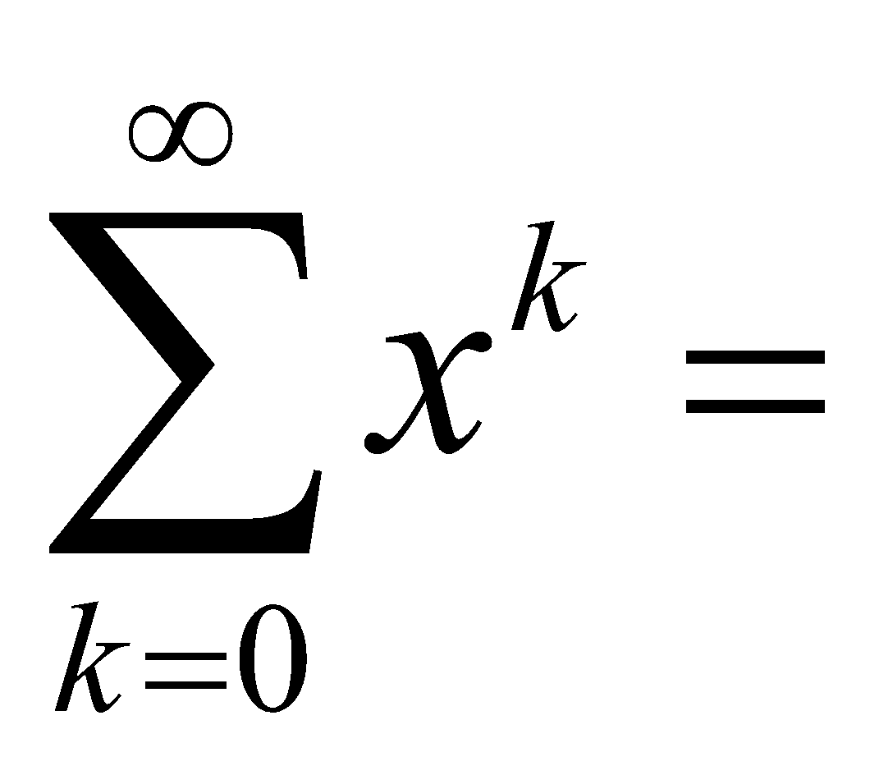
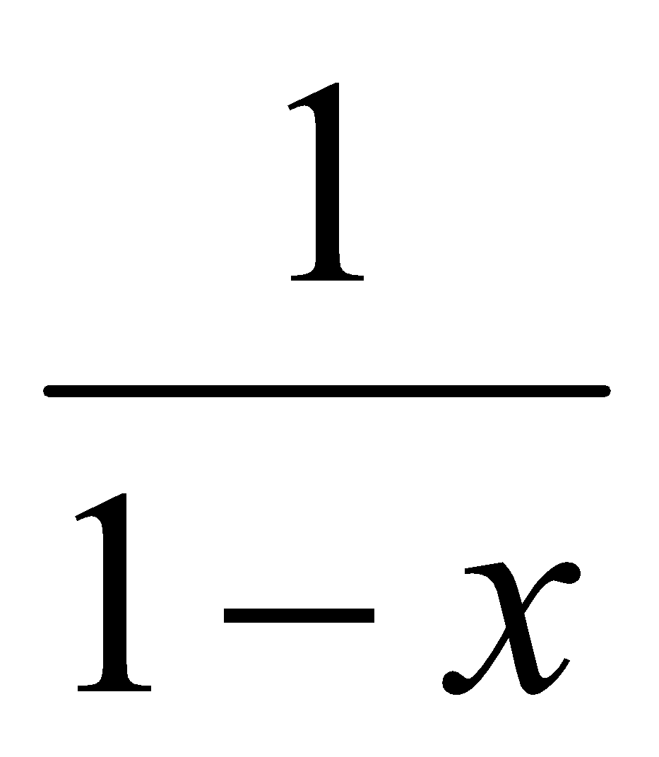
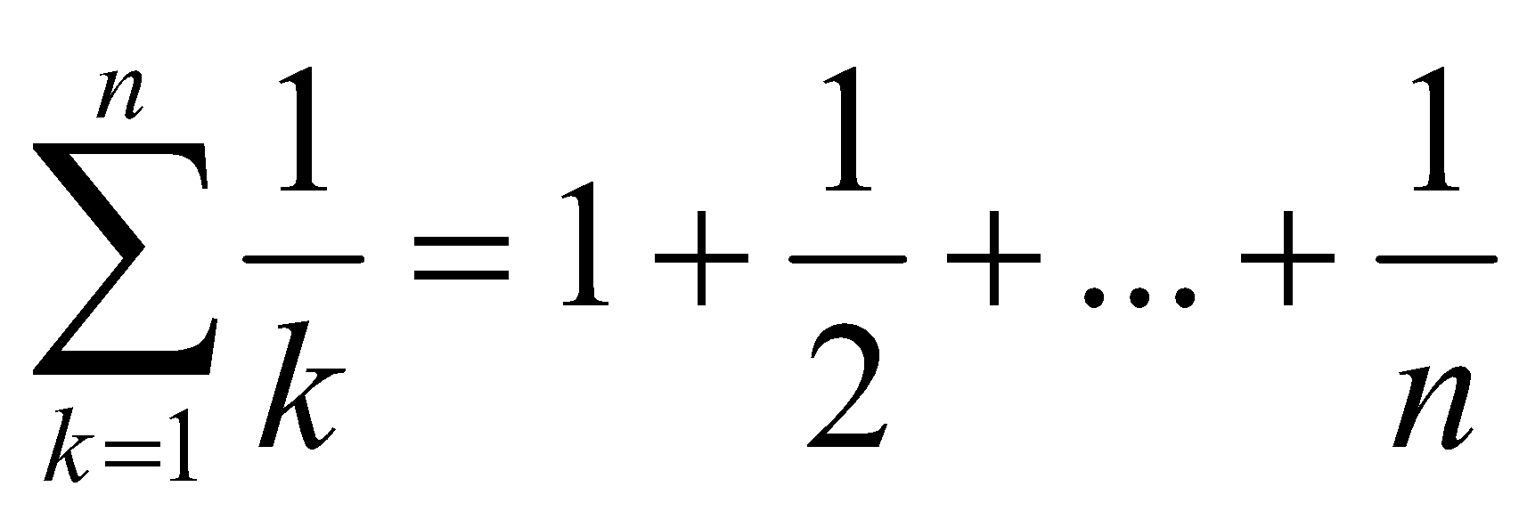
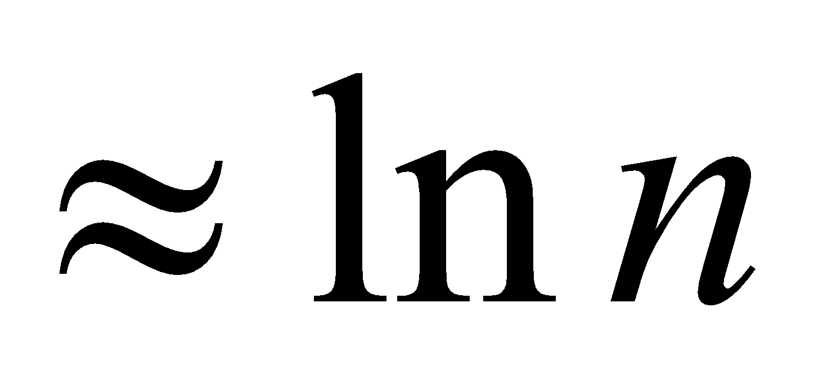
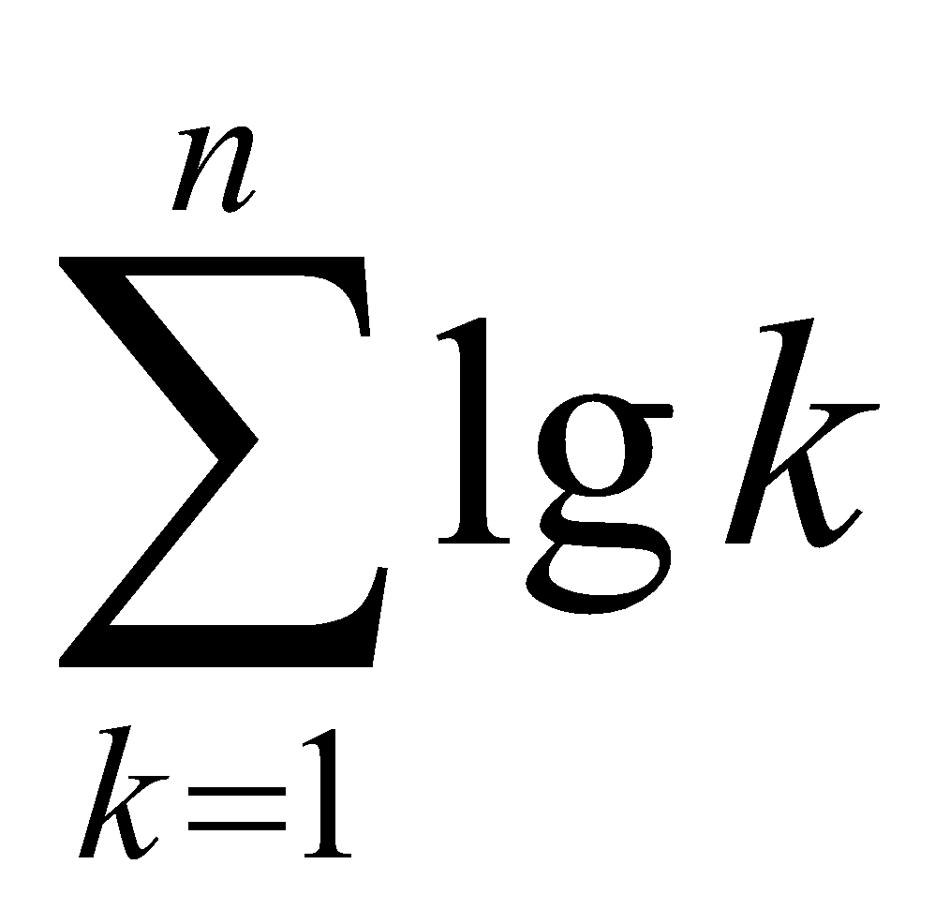
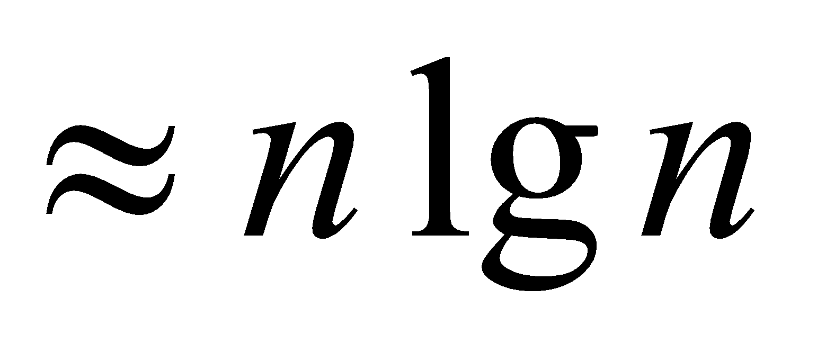
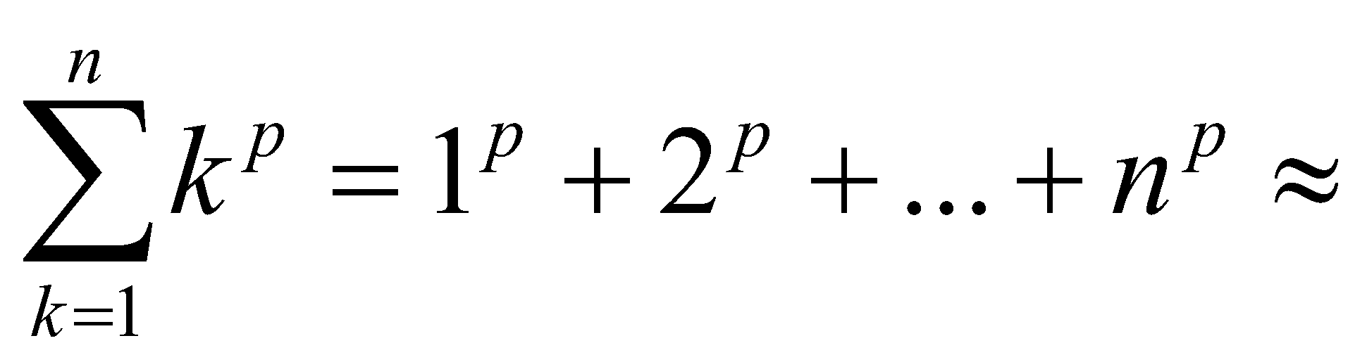
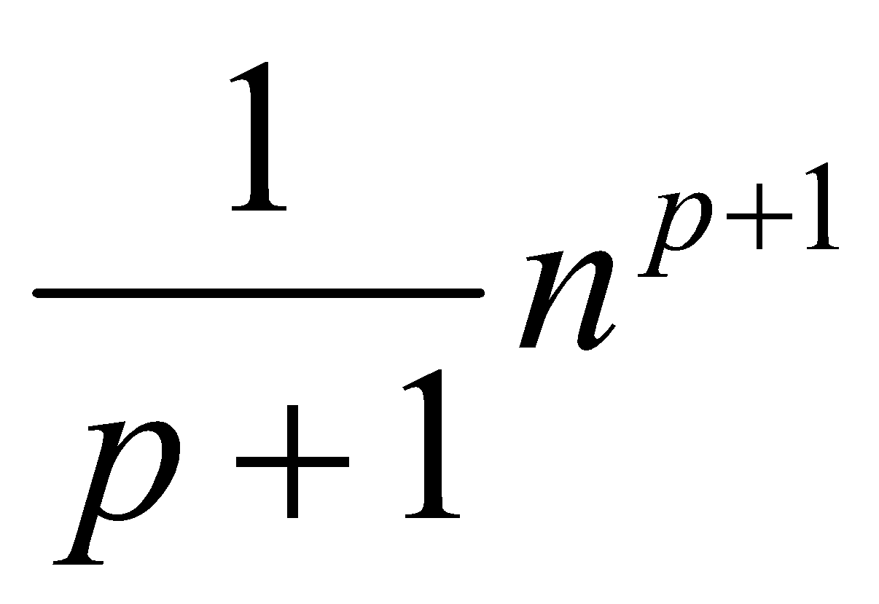
Common Summations
Arithmetic series:
Geometric series:
Special case: |x| < 1:
Harmonic series:
Other important formulas:
‹#›

Slide 36
Mathematical Induction
A powerful, rigorous technique for proving that a statement S(n) is true for every natural number n, no matter how large.
Proof:
Basis step: prove that the statement is true for n = 1
Inductive step: assume that S(n) is true and prove that S(n+1) is true for all n ≥ 1
Find case n “within” case n+1
‹#›

Slide 37
Example
Prove that: 2n + 1 ≤ 2^{n} for all n ≥ 3
Basis step:
n = 3: 2 * 3 + 1 ≤ 2³ ⇔ 7 ≤ 8 TRUE
Inductive step:
Assume inequality is true for n, and prove it for (n+1):
2n + 1 ≤ 2^{n} must prove: 2(n + 1) + 1 ≤ 2^{n+1}
2(n + 1) + 1 = (2n + 1 ) + 2 ≤ 2^{n} + 2 ≤
≤ 2^{n} + 2^{n} = 2^{n+1}, since 2 ≤ 2^{n} for n ≥ 1
‹#›

